Slide 1
ECE314 Lab 5 Overview
Bloom filer
Min Hashing

Slide 2
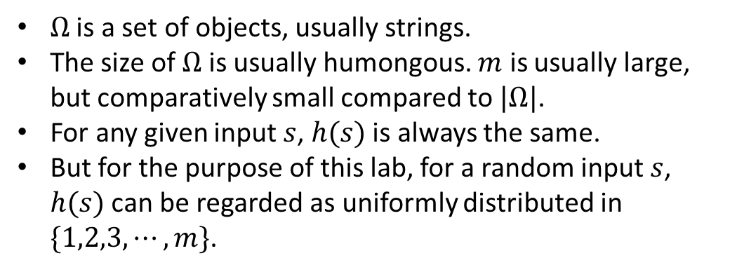
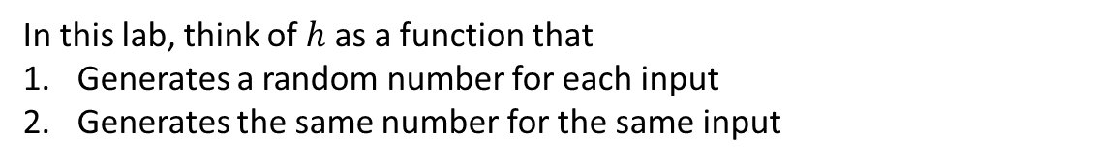
Hash function
$$h:Ω→\{1,2,3,⋯,m\}$$
$Ω$ is a set of objects, usually strings.
The size of $Ω$ is usually humongous. $m$ is usually large, but comparatively small compared to $|Ω|$.
For any given input $s$, $h(s)$ is always the same.
But for the purpose of this lab, for a random input $s$, $h(s)$ can be regarded as uniformly distributed in $\{1,2,3,⋯,m\}$.
In this lab, think of $h$ as a function that
Generates a random number for each input
Generates the same number for the same input

Slide 3
Bloom filter
Purpose: Efficient membership check
Membership
Check
Is ‘Jack’ a student of ECE314?
YES

Slide 4
Bloom filter
Purpose: Efficient membership check
Membership
Check
Is ‘Ben’ a student of ECE314?
NO

Slide 5

Bloom filter
Purpose: Efficient membership check
‘Ann’
‘Daniel’
‘George’
‘Jack’
‘John’
$⋮$
Problems: not efficient in
Memory usage
Searching time
A naïve solution: using a list

Slide 6




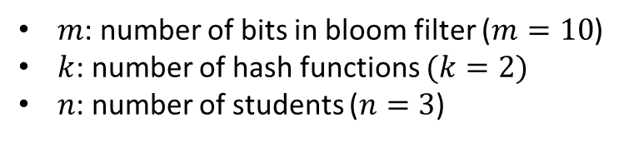







Bloom filter
$$1$$
$$2$$
$$3$$
$$4$$
$$5$$
$$6$$
$$7$$
$$8$$
$$9$$
$$10$$
B
0 | 0 | 0 | 0 | 0 | 0 | 0 | 0 | 0 | 0
List of students: ‘Jack’, ‘Bruce’, ‘Jane’
Hash functions: $h_{1}$, $h_{2}$
$m$: number of bits in bloom filter ($m=10$)
$k$: number of hash functions $(k=2)$
$n$: number of students ($n=3$)
Stage 1: Store

Slide 7

Bloom filter
$$1$$
$$2$$
$$3$$
$$4$$
$$5$$
$$6$$
$$7$$
$$8$$
$$9$$
$$10$$
B
0 | 0 | 0 | 0 | 0 | 0 | 0 | 0 | 0 | 0
List of students: ‘Jack’, ‘Bruce’, ‘Jane’
Hash functions: $h_{1}$, $h_{2}$
$m$: number of bits in bloom filter ($m=10$)
$k$: number of hash functions $(k=2)$
$n$: number of students ($n=3$)
Stage 1: Store
$$h_{1}\left(′Jack^{′}\right)=4$$

Slide 8
Bloom filter
$$1$$
$$2$$
$$3$$
$$4$$
$$5$$
$$6$$
$$7$$
$$8$$
$$9$$
$$10$$
B
0 | 0 | 0 | 1 | 0 | 0 | 0 | 0 | 0 | 0
List of students: ‘Jack’, ‘Bruce’, ‘Jane’
Hash functions: $h_{1}$, $h_{2}$
$m$: number of bits in bloom filter ($m=10$)
$k$: number of hash functions $(k=2)$
$n$: number of students ($n=3$)
Stage 1: Store
$$h_{1}\left(′Jack^{′}\right)=4$$

Slide 9

Bloom filter
$$1$$
$$2$$
$$3$$
$$4$$
$$5$$
$$6$$
$$7$$
$$8$$
$$9$$
$$10$$
B
0 | 0 | 0 | 1 | 0 | 0 | 0 | 0 | 0 | 0
List of students: ‘Jack’, ‘Bruce’, ‘Jane’
Hash functions: $h_{1}$, $h_{2}$
$m$: number of bits in bloom filter ($m=10$)
$k$: number of hash functions $(k=2)$
$n$: number of students ($n=3$)
Stage 1: Store
$$h_{1}\left(′Jack^{′}\right)=4$$
$$h_{2}\left(′Jack′\right)=1$$

Slide 10
Bloom filter
$$1$$
$$2$$
$$3$$
$$4$$
$$5$$
$$6$$
$$7$$
$$8$$
$$9$$
$$10$$
B
1 | 0 | 0 | 1 | 0 | 0 | 0 | 0 | 0 | 0
List of students: ‘Jack’, ‘Bruce’, ‘Jane’
Hash functions: $h_{1}$, $h_{2}$
$m$: number of bits in bloom filter ($m=10$)
$k$: number of hash functions $(k=2)$
$n$: number of students ($n=3$)
Stage 1: Store
$$h_{1}\left(′Jack^{′}\right)=4$$
$$h_{2}\left(′Jack′\right)=1$$

Slide 11

Bloom filter
$$1$$
$$2$$
$$3$$
$$4$$
$$5$$
$$6$$
$$7$$
$$8$$
$$9$$
$$10$$
B
1 | 0 | 0 | 1 | 0 | 0 | 0 | 0 | 0 | 0
List of students: ‘Jack’, ‘Bruce’, ‘Jane’
Hash functions: $h_{1}$, $h_{2}$
$m$: number of bits in bloom filter ($m=10$)
$k$: number of hash functions $(k=2)$
$n$: number of students ($n=3$)
Stage 1: Store
$$h_{1}\left(′Jack^{′}\right)=4$$
$$h_{2}\left(′Jack′\right)=1$$
$$h_{1}\left(′Bruce^{′}\right)=9$$

Slide 12
Bloom filter
$$1$$
$$2$$
$$3$$
$$4$$
$$5$$
$$6$$
$$7$$
$$8$$
$$9$$
$$10$$
B
1 | 0 | 0 | 1 | 0 | 0 | 0 | 0 | 1 | 0
List of students: ‘Jack’, ‘Bruce’, ‘Jane’
Hash functions: $h_{1}$, $h_{2}$
$m$: number of bits in bloom filter ($m=10$)
$k$: number of hash functions $(k=2)$
$n$: number of students ($n=3$)
Stage 1: Store
$$h_{1}\left(′Jack^{′}\right)=4$$
$$h_{2}\left(′Jack′\right)=1$$
$$h_{1}\left(′Bruce^{′}\right)=9$$

Slide 13

Bloom filter
$$1$$
$$2$$
$$3$$
$$4$$
$$5$$
$$6$$
$$7$$
$$8$$
$$9$$
$$10$$
B
1 | 0 | 0 | 1 | 0 | 0 | 0 | 0 | 1 | 0
List of students: ‘Jack’, ‘Bruce’, ‘Jane’
Hash functions: $h_{1}$, $h_{2}$
$m$: number of bits in bloom filter ($m=10$)
$k$: number of hash functions $(k=2)$
$n$: number of students ($n=3$)
Stage 1: Store
$$h_{1}\left(′Jack^{′}\right)=4$$
$$h_{2}\left(′Jack′\right)=1$$
$$h_{1}\left(′Bruce^{′}\right)=9$$
$$h_{2}\left(′Bruce^{′}\right)=5$$

Slide 14
Bloom filter
$$1$$
$$2$$
$$3$$
$$4$$
$$5$$
$$6$$
$$7$$
$$8$$
$$9$$
$$10$$
B
1 | 0 | 0 | 1 | 1 | 0 | 0 | 0 | 1 | 0
List of students: ‘Jack’, ‘Bruce’, ‘Jane’
Hash functions: $h_{1}$, $h_{2}$
$m$: number of bits in bloom filter ($m=10$)
$k$: number of hash functions $(k=2)$
$n$: number of students ($n=3$)
Stage 1: Store
$$h_{1}\left(′Jack^{′}\right)=4$$
$$h_{2}\left(′Jack′\right)=1$$
$$h_{1}\left(′Bruce^{′}\right)=9$$
$$h_{2}\left(′Bruce^{′}\right)=5$$

Slide 15

Bloom filter
$$1$$
$$2$$
$$3$$
$$4$$
$$5$$
$$6$$
$$7$$
$$8$$
$$9$$
$$10$$
B
1 | 0 | 0 | 1 | 1 | 0 | 0 | 0 | 1 | 0
List of students: ‘Jack’, ‘Bruce’, ‘Jane’
Hash functions: $h_{1}$, $h_{2}$
$m$: number of bits in bloom filter ($m=10$)
$k$: number of hash functions $(k=2)$
$n$: number of students ($n=3$)
Stage 1: Store
$$h_{1}\left(′Jack^{′}\right)=4$$
$$h_{2}\left(′Jack′\right)=1$$
$$h_{1}\left(′Bruce^{′}\right)=9$$
$$h_{2}\left(′Bruce^{′}\right)=5$$
$$h_{1}\left(′Jane^{′}\right)=4$$

Slide 16

Bloom filter
$$1$$
$$2$$
$$3$$
$$4$$
$$5$$
$$6$$
$$7$$
$$8$$
$$9$$
$$10$$
B
1 | 0 | 0 | 1 | 1 | 0 | 0 | 0 | 1 | 0
List of students: ‘Jack’, ‘Bruce’, ‘Jane’
Hash functions: $h_{1}$, $h_{2}$
$m$: number of bits in bloom filter ($m=10$)
$k$: number of hash functions $(k=2)$
$n$: number of students ($n=3$)
Stage 1: Store
$$h_{1}\left(′Jack^{′}\right)=4$$
$$h_{2}\left(′Jack′\right)=1$$
$$h_{1}\left(′Bruce^{′}\right)=9$$
$$h_{2}\left(′Bruce^{′}\right)=5$$
$$h_{1}\left(′Jane^{′}\right)=4$$
$$h_{2}\left(′Jane^{′}\right)=2$$

Slide 17
Bloom filter
$$1$$
$$2$$
$$3$$
$$4$$
$$5$$
$$6$$
$$7$$
$$8$$
$$9$$
$$10$$
B
1 | 1 | 0 | 1 | 1 | 0 | 0 | 0 | 1 | 0
List of students: ‘Jack’, ‘Bruce’, ‘Jane’
Hash functions: $h_{1}$, $h_{2}$
$m$: number of bits in bloom filter ($m=10$)
$k$: number of hash functions $(k=2)$
$n$: number of students ($n=3$)
Stage 1: Store
$$h_{1}\left(′Jack^{′}\right)=4$$
$$h_{2}\left(′Jack′\right)=1$$
$$h_{1}\left(′Bruce^{′}\right)=9$$
$$h_{2}\left(′Bruce^{′}\right)=5$$
$$h_{1}\left(′Jane^{′}\right)=4$$
$$h_{2}\left(′Jane^{′}\right)=2$$

Slide 18







Bloom filter
$$1$$
$$2$$
$$3$$
$$4$$
$$5$$
$$6$$
$$7$$
$$8$$
$$9$$
$$10$$
B
1 | 1 | 0 | 1 | 1 | 0 | 0 | 0 | 1 | 0
List of students: ‘Jack’, ‘Bruce’, ‘Jane’
Hash functions: $h_{1}$, $h_{2}$
$m$: number of bits in bloom filter ($m=10$)
$k$: number of hash functions $(k=2)$
$n$: number of students ($n=3$)
Performance evaluation: $\operatorname{Pr}{(false positive)}$
Stage 1: Store
Stage 2: Check
Is ‘Jack’ a student of ECE314?
$$h_{1}\left(′Jack^{′}\right)=4$$
$$h_{2}\left(′Jack′\right)=1$$
$$h_{1}\left(′Jack^{′}\right)=4$$
$$h_{2}\left(′Jack′\right)=1$$
Probably Yes
$$h_{1}\left(′Bruce^{′}\right)=9$$
$$h_{2}\left(′Bruce^{′}\right)=5$$
Is ‘Donald’ a student of ECE314?
$$h_{1}\left(′Jane^{′}\right)=4$$
$$h_{2}\left(′Jane^{′}\right)=2$$
$$h_{1}\left(′Donald^{′}\right)=5$$
$$h_{2}\left(′Donald^{′}\right)=1$$
Probably Yes
False positive
Is ‘Edwin’ a student of ECE314?
$$h_{1}\left(′Edwin^{′}\right)=2$$
$$h_{2}\left(′Edwin^{′}\right)=6$$
No

Slide 19
Min Hashing
Purpose: Efficiently determine the similarity between two sets.
Document A: Jack and Jill went up the hill to fetch a pail of water.
Document B: Up the hill, Jack and Jill went to get a pail of water.

Slide 20
Min Hashing
Purpose: Efficiently determine the similarity between two sets.
Document A: Jack and Jill went up the hill to fetch a pail of water.
Document B: Up the hill, Jack and Jill went to get a pail of water.

Slide 21

Min Hashing
Purpose: Efficiently determine the similarity between two sets.
Document A: Jack and Jill went up the hill to fetch a pail of water.
Document B: Up the hill, Jack and Jill went to get a pail of water.
shingles | Doc A | Doc B
Jack Jill | 1 | 1
Jill went | 1 | 1
went up | 1 | 0
up hill | 1 | 1
hill fetch | 1 | 0
fetch pail | 1 | 0
pail water | 1 | 1
hill Jack | 0 | 1
went get | 0 | 1
get pail | 0 | 1
Jaccard measure: $J\left(A,B\right)=\frac{|A∩B|}{|A∪B|}$

Slide 22

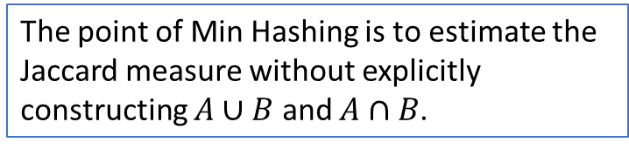
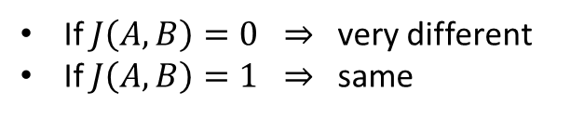
Min Hashing
Purpose: Efficiently determine the similarity between two sets.
Document A: Jack and Jill went up the hill to fetch a pail of water.
Document B: Up the hill, Jack and Jill went to get a pail of water.
shingles | Doc A | Doc B
Jack Jill | 1 | 1
Jill went | 1 | 1
went up | 1 | 0
up hill | 1 | 1
hill fetch | 1 | 0
fetch pail | 1 | 0
pail water | 1 | 1
hill Jack | 0 | 1
went get | 0 | 1
get pail | 0 | 1
Jaccard measure: $J\left(A,B\right)=\frac{|A∩B|}{|A∪B|}$
$$= \frac{4}{10}=0.4$$
Very similar
If $J\left(A,B\right)=0 ⇒$ very different
If $J\left(A,B\right)=1 ⇒$ same
What if you have many documents and each document is large?
The point of Min Hashing is to estimate the Jaccard measure without explicitly constructing $A∪B$ and $A∩B$.

